Slide 1


COCOMA – a framework for COntrolled COntentious and MAlicious patterns
Carmelo Ragusa and Philip Robinson,
SAP Belfast
RG SPEC, 17 October 2012

Slide 2
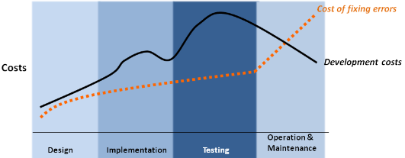
The General Business Problem of Software Testing
Testing is Expensive (30 – 50% of Budget [1])
…but so are bugs [2]
[1] M-C. Ballou, "Improving Software Quality to Drive Business Agility", IDC Survey and White Paper (Sponsored by Coverity Inc.), 2008
[2] B. Gauf, E. Dustin, "The Case for Automated Software Testing", Journal of Software Technology, v.10, n.3, October 2007

Slide 3
Using the Cloud for testing, but what does it mean?
Different flavours:
  In-cloud testing:
    Performed inside a cloud to ensure the quality of the services offered by the cloud infrastructure itself
  Cloud for testing:
    Using the cloud to create a critical mass of users/traffic towards a System Under Test
  Over-cloud testing:
    To ensure the quality of the end-to-end cloud-application over the cloud

Slide 4




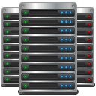
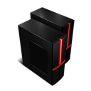





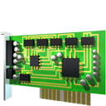



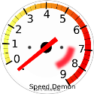
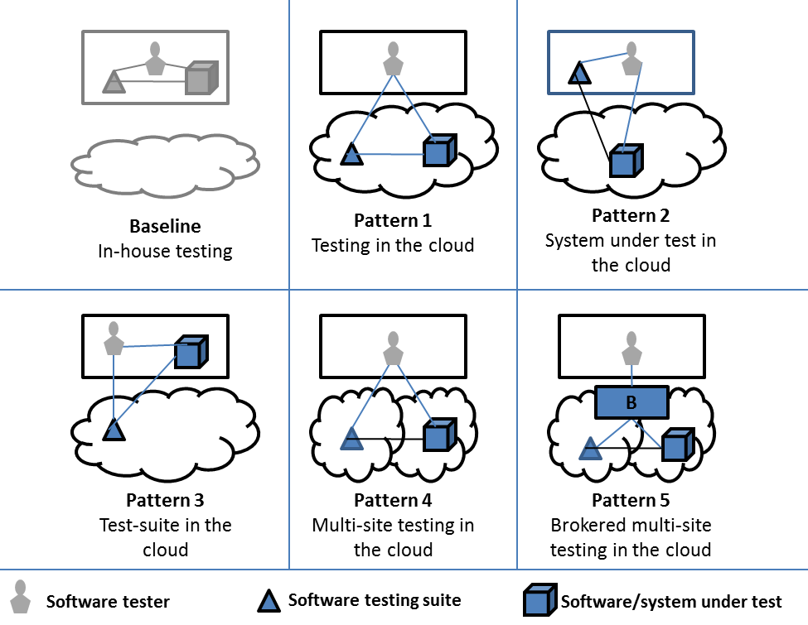

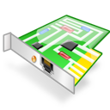

Difficult to decide!
?
?
Notes:
A tester that wants to test his cloud application in the cloud faces many difficulties
Many cloud providers with different features
Different performances
Different usage patterns
So the question is, how would you pick your cloud provider to test your cloud application?

Slide 5
What do we want then?
Our research questions, when executing testing of a SuT in a cloud infrastructure, are the following:
  How can we assess the platform where tests are carried out?
  How can we compare the different platforms where we can carry out our tests?
  Which infrastructure pattern to carry out our tests is more effective for our SuT specific needs?
SAP is partner in BonFIRE*, FP7 project: A multi-site cloud facility for applications, services and systems research and experimentation
SAP was in charge of one of the native experiments (concluded in May 2012), Effective Cloud software testing
* Acknowledgment: The BonFIRE project has received research funding from the EC's Seventh Framework Programs (EU ICT-2009-257386 IP under the Information and Communication Technologies Program).
Notes:
The BonFIRE (Building service testbeds for Future Internet Research and Experimentation) Project provides a state-of-the art multi-site cloud facility for applications, services and systems research. The facility gives researchers access to large-scale virtualised compute, storage and networking resources with high level of control and monitoring services for detailed experimentation of their systems and applications. The facility allows the evaluation of cross-cutting effects of converged service and network infrastructures.

Slide 6
What we have done so far
→ We derived a set of criteria for assessing and comparing the effectiveness of platforms and infrastructure patterns for supporting cloud software testing:
    Identified an initial set from preliminary studies published in [3]:
      Cost-effectiveness
      Simplicity
      Target representation
      Observability
      Controllability
      Predictability
      Reproducibility
    Extended and refined from conducting our experiment in BonFIRE:
      Availability
      Reliability
      Reproducible environment conditions
[3] Robinson, P. and Ragusa, C. (2011) "Taxonomy and Requirements Rationalization for Infrastructure in Cloud-based Software Testing", Proceedings of the IEEE International Conference and Workshops on Cloud Computing Technology and Science (CloudCom)
Notes:
In our published preliminary study we identified a set of criteria: cost-effectiveness, simplicity, target representation, controllability, observability, predictability, reproducibility
Experiment 1, WP4.1 of BonFIRE was in the area of Effective Cloud Software Testing. Here we extended and refined our set by adding further criteria: availability, reliability and reproducible environment conditions

Slide 7
Reproducing environment conditions
How can we create/manage/control reproducible environment conditions?
In what environment conditions are we interested?
    Contentiousness
    Maliciousness
    Faultiness
→ COntrolled COntentious and MAlicious patterns => deliberately make the platform “misbehave” – contention, faults and attacks
Soft-ware
Unknown
Cloud
Infrastructure
Notes:
We refer to this solution as COCOMA - a framework for Controlled, Contentious and Malicious patterns. COCOMA essentially provides support to an experimenter or software tester in controlling the behaviour of the platform during a specific experiment or software test. COCOMA's goal is to provide mechanisms for deliberate introduction of VMs during an experiment or test setup that contend for resources, interfere with resource availabilities or attempt vulnerability exploits such as buffer-overflows, side-channel attacks or flooding. COCOMA should provide a simple interface for setting up these patterns in a cost (time)-effective, controllable, predictable and reproducible manner. COCOMA should also log resource states over time such that correlation of behaviours with experiment stages is easier for the experimenter. The patterns should represent synthetic or real behaviours from traces of systems during production. The design, development and integration of COCOMA is being led by SAP and will be released as open-source.

Slide 8
Approach: Effect Emulation versus Cause Emulation
State of the art: Cause Emulation in SW Testing (e.g. Create instances of colocated workloads)
COCOMA Approach: Effect Emulation in SW Testing (e.g. Emulate resource effects of colocated workloads)
Load
1
2
3
*
Load
1
SuT
1
2
3
*
SuT
COCOMA
Test Environment
Test Environment
1
2
3
*
Notes:
Current approach to recreate a contentious environment at testing stage is for the experimenter to emulate the contentiousness cause by deploying different instances beside their SuT.
On the other hand, COCOMA aims to achieve the same objective by emulating the contentiousness effects by appropriately loading the resources at the SuT deployed host.
An experimenter will be able to create an environment where deliberate contentious and malicious payloads and workloads can be generated. The experimenter will also be able to use pre-defined common distribution or specify new payload and workloads. Once the emulation is started metrics will be exposed in order to allow dynamic monitoring and correlation of the emulated environment with the experiment. Logs will be also recorded so that off-line studies can be carried out.

Slide 9
Use case: COCOMA walkthrough in BonFIRE
From RESTfully client
  Deploy SuT, Zabbix and COCOMA
  Create emulation
From COCOMA
  Create a distribution
  Schedule runs of the distribution
  Send metrics values to Zabbix
Start Load to SuT
From RESTfully client
  Manage emulation
    Check status
    Delete
    …
From COCOMA
  Emulation Logs are saved
RESTfully script
Load
Create emulation
Check emulation
Zabbix
SuT
COCOMA
Emulation
BonFIRE Onrequest
Distribution
1
2
*
3
Notes:
In order to be effective an experiment that includes COCOMA has to be deployed to dedicated physical resources, such as the ones provided by BonFIRE onrequest.
The COCOMA framework can be provided as a ready to use appliance into one or more BonFIRE VMs, depending on the configuration the user decides to use (colocated DB or DB in a different VM). COCOMA REST APIs can be used through BonFIRE RESTfully client (which is an open-source tool) to include COCOMA VM(s) into the experiment deployment, to create and manage emulations and to gather results.
Regarding emulations monitoring, COCOMA is designed to work with different monitoring frameworks by wrapping the relative probes. In the case of BonFIRE, the well known Zabbix will be used. Once COCOMA VM(s) starts it is contextualised appropriately through BonFIRE contextualisation mechanisms (e.g. OCCI, RESTfully), for example to get Zabbix IP.
Once the experiment is concluded, the experimenter can correlate the performance/behaviour of his/her SuT with the COCOMA distribution used, and derive appropriate conclusions such as identified bottlenecks, weaknesses, etc.

Slide 10


Distributions in COCOMA
Contentious
Target resources
    CPU
    RAM
    I/O
    Network
  Patterns
    Linear
    Poisson
    …
    Cloud specific
Malicious
Privileges
    Browse/listen
    Basic user
    Advanced user
    Admin user
    Owner
  Payloads
    Snoop/scan
    Read
    Alter
    Deny/damage
    Control
Notes:
For the malicious one: an experimenter may define a baseline where for him a user with browse/listen privileges can only snoop/scan. But if when running the emulation the user is able to read, then for the experimenter the system failed the security test.

Slide 11





COCOMA Design
SuT
COCOMA
Stressapptest
Test Environment
Notes:
The architecture is presented through the so called separation of concerns.
User can interact with the framework through a CLI (ccmsh) or through REST API. In the future we’ll add a web GUI.
Interaction among components is:
an experimenter creates an emulation issuing a command such as:
createEmulation(emulationType, resourceType, start, stop, distributionName, distribution-parameters)
The emulationManager creates the emulation and inserts it in the emulationsTable of the DB
once an emulation is created, the distributionManager receives it, processes it and
creates emulationLifetimeInstance that holds start(Time/event), stop(Time/event). In case of events, sources of the events are also needed
creates distribution<Type>Instance which holds the distribution parameters requested by the developer and the emulator matched (DB emulatorID) by the distributionManager
updates the aggregator to aggregate the relative metrics (e.g. …)
the distribution<Type>Instance splits the distribution in multiple runs which are sent to a scheduler
the scheduler starts the runs at due time
the probeInstance(s) send metrics values to the aggregator
the aggregator saves data into the DB. It also updates the distributionManager on the running status
the distributionManager gets regular status updates, check current emulations and takes necessary actions
from the CLI/REST API the experimenter can get details, check the current status or delete the emulation created
Components are implemented in python, the DB can be SQLite or other DB (if we see higher needs). Tools like wireshark, Nmap, stressapptest, lookbusy will be used to create the basic runs.

Slide 12
Benefits in adopting COCOMA
  Experimenters will be able to
    study their system under real world effects conditions
    control those conditions
    correlate distributions and performances/results of their system under test
    use those findings to discover weaknesses and tune/enhance their system
  COCOMA will be released as open source under Apache v2 license
    We envisage new distributions contributions to the framework
      Ideally “common” cloud patterns which can be validated and afterwards used by other experimenters
  Easy integration within an existing infrastructure
  Ability to create and reproduce complex experimental scenarios

Slide 13
Potential Stakeholders
Cloud Service Providers
    E.g. Enhance cloud management with infrastructure assessment
Cloud Application Administrators
    E.g. Enhance cloud application management with platform assessment
Application Developers and Testers
    E.g. Contributing to PaaS application testing best-practices
Benchmarks and Standards Groups
    E.g. Possible contribution to validation of cloud usage patterns (SPEC – RG Cloud WG)
Notes:
Cloud providers
to study and analyse optimization and security strategies for their applications within their multi-tenancy environment
Understanding how applications with different workloads can be colocated or not
Cloud application administrators, to analyse, optimise and secure the applications they are managing
Application developers and testers, to study their system under real world effects conditions by controlling those conditions so that correlations between the emulated environment and results of the system under test can be investigated in terms of performance and security
Currently the SPEC research working group is looking into cloud usage patterns. We believe that COCOMA can fit into the cloud usage patterns process, in particular in the validation stage, where specific emulations representing cloud usage patterns can be executed in COCOMA and thus evaluated
Future features
Web GUI
Distributed version

Slide 14
Thank You!

