Slide 1




Metrics and Techniques for Quantifying Performance Isolation in Cloud Environments
Rouven Krebs (SAP AG), Christof Momm (SAP AG), Samuel Kounev (KIT)
SPEC RG Cloud, May 2012

Slide 2
Isolation and Shared Resources
High overhead, low utilization
→ need to share
Middleware
Middleware
Middleware
Application
Application
Application
provides
Operating System
Operating System
Operating System
Hardware
Hardware
Hardware
Service Provider

Slide 3
Isolation and Shared Resources
Performance guarantees
Different performance isolation methods.
Middleware
Application
provides
Operating System
Virtualization
Service Provider
Hardware

Slide 4

Questions
Q1: How strong is one tenant’s influence onto the others?
Q2: How much is a system better isolated than a non- isolated system?
Performance isolation methods
How to quantify isolation?
Q3: How much potential has the method to improve?
Introduction Metrics Isolation Methods Conclusion/Related Work

Slide 5
Definition of Performance Isolation
Tenants working within their assigned quota (e.g., #Users) should not suffer from tenants exceeding their quotas.
Load t1 > Quota
Load t1 > Quota
Load t2 < Quota
Load t2 < Quota
Response Time t1
Response Time t1
Response Time t2
Response Time t2
Time
Time
Non-Isolated
Isolated
Introduction Metrics Isolation Methods Conclusion/Related Work

Slide 6
Contributions
Contribution I
Metrics to quantify the performance isolation of shared systems.
Contribution II
Measurement techniques for quantifying the proposed metrics.
Contribution III
Approaches for performance isolation at the architectural level in SaaS environments.
Introduction Metrics Isolation Methods Conclusion/Related Work

Slide 7
Performance Isolation Metrics: Basic Idea
D is a set of disruptive tenants exceeding their quotas.
A is a set of abiding tenants not exceeding their quotas.
Workload
Response Time
Time
Time
Impact of increased workload of the disruptive tenants onto the response time of the abiding ones.
Introduction Metrics Isolation Methods Conclusion/Related Work

Slide 8
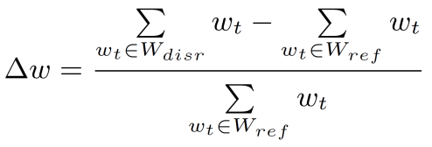
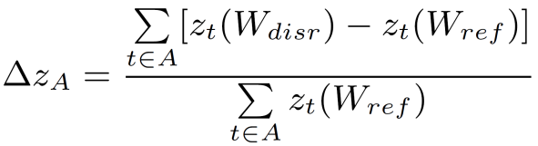
Metric I: Based on QoS Impact
Reference Workload W_{ref}
Disruptive Workload W_{disr}
Load
Load
A
Avg. Response Time for all Tenants in A
Tenants
seconds
Tenants
t1
t2
t3
t4
t1
t2
t3
t4
Different
Response
Times
Workload
W_{ref}
W_{disr}
Introduction Metrics Isolation Methods Conclusion/Related Work

Slide 9
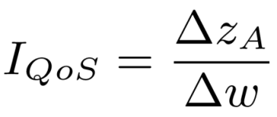
Metric I: Based on QoS Impact
Difference in Response Time
Difference in Workload
Perfectly Isolated = 0
Non-Isolated = ?
Answers Q1: How strong is a tenant’s influence onto the others?
Introduction Metrics Isolation Methods Conclusion/Related Work

Slide 10
Metrics Based on Workload Ratio - Idea
Non-Isolated
#Users for t1 | #Users for t2 | Response Time t1 | Response Time t2
50 | 50 | 1s | 1s
55 | 50 | 1.1s | 1.1s
55 | 45 | 1s | 1s
Isolated
#Users for t1 | #Users for t2 | Response Time t1 | Response Time t2
50 | 50 | 1s | 1s
55 | 50 | 1.1s | 1s
60 | 50 | 1.3s | 1s
By decreasing workload of the abiding tenant, it is possible to maintain the QoS for them.
Introduction Metrics Isolation Methods Conclusion/Related Work

Slide 11
Metrics Based on Workload Ratio - Idea
Workload
Response Time
Time
Time
Response Time
Workload
Time
Time
Introduction Metrics Isolation Methods Conclusion/Related Work

Slide 12
Metrics Based on Workload Ratio
Stable QoS for the abiding tenant’s residual users. Pareto optimum with regards to total workload.
Abiding Workload
Non-Isolated
Disruptive Workload
Introduction Metrics Isolation Methods Conclusion/Related Work

Slide 13
Metrics Based on Workload Ratio
We maintain the QoS for the abiding tenant without decreasing his workload.
Abiding Workload
Isolated
Disruptive Workload
Introduction Metrics Isolation Methods Conclusion/Related Work

Slide 14
Metrics Based on Workload Ratio
Abiding Workload
W_{aref} = W_{dbase} - W_{dref}
W_{aref}
Isolated
W_{abase}
Observed System
Non-Isolated
W_{dref}
W_{dbase}
W_{dend}
Disruptive Workload
Introduction Metrics Isolation Methods Conclusion/Related Work

Slide 15
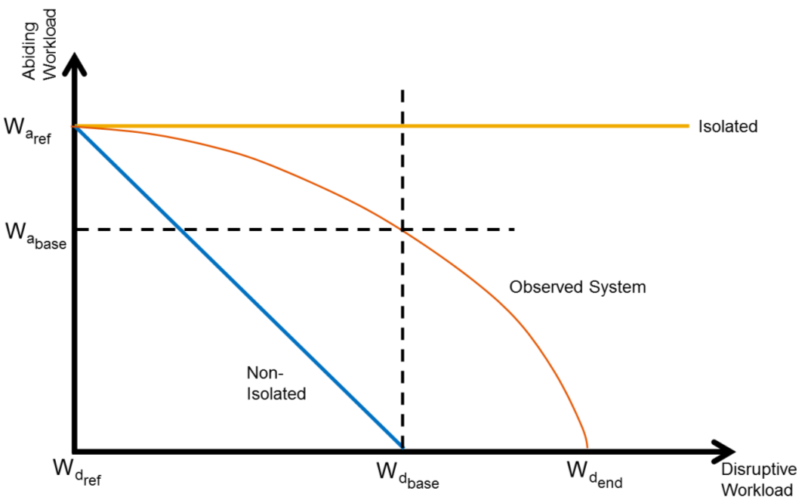
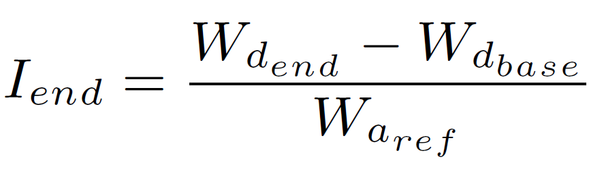
Metric II: Based on Workload Ratio I_{end}
Perfectly Isolated = ?
Non-Isolated = 0
Answers Q2: Is the system better isolated than a non- isolated system.
Introduction Metrics Isolation Methods Conclusion/Related Work
Notes:
narrate this slide use "workload
unit" instead of "piece of workload".

Slide 16
Metrics Based on Workload Ratio
Integrals
Abiding Workload
W_{aref}
Isolated
W_{abase}
A_{measured}
Observed System
Non-Isolated
W_{dref}
W_{dbase}
W_{dend}
Disruptive Workload
Introduction Metrics Isolation Methods Conclusion/Related Work

Slide 17
Metrics Based on Workload Ratio
Integrals
Abiding Workload
W_{aref}
Isolated
W_{abase}
Observed System
A_{nonIsolated}
Non-Isolated
W_{dref}
W_{dbase}
W_{dend}
Disruptive Workload
Introduction Metrics Isolation Methods Conclusion/Related Work

Slide 18
Metrics Based on Workload Ratio
Integrals
Abiding Workload
W_{aref}
Isolated
A_{Isolated}
W_{abase}
Observed System
Non-Isolated
W_{dref}
W_{dbase}
W_{dend}
p_{end}
Disruptive Workload
Introduction Metrics Isolation Methods Conclusion/Related Work

Slide 19
Metrics Based on Workload Ratio
Integrals: Basic Idea
Abiding Workload
I = (A_{measured} – A_{nonIsolated})/A_{isolated} - A_{nonIsolated}
A_{nonIsolated} = W_{aref}* W_{aref} / 2
W_{aref}
Isolated
A_{Isolated}
W_{abase}
A_{measured}
Observed System
A_{nonIsolated}
Non-Isolated
W_{dref}
W_{dbase}
W_{dend}
Disruptive Workload
Introduction Metrics Isolation Methods Conclusion/Related Work

Slide 20
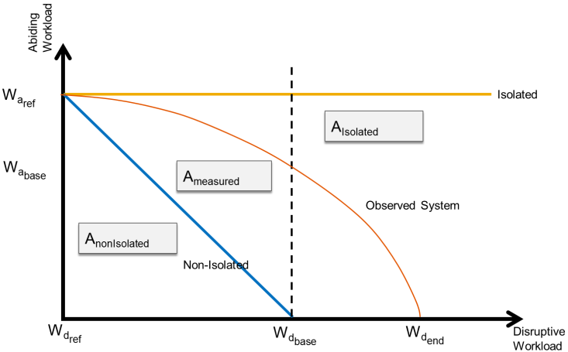
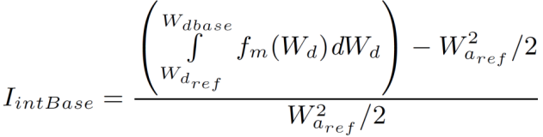
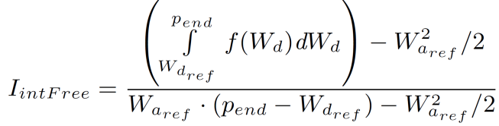
Metrics Based on Workload Ratio
Integrals: I_{intBase} and I_{intFree}
Areas within W_{dref} and W_{dbase}.
Areas within W_{dref} and predefined bound.
Perfectly Isolated = 1
Non-Isolated = 0
Answers Q3: How much potential has the isolation method to improve.
Introduction Metrics Isolation Methods Conclusion/Related Work

Slide 21
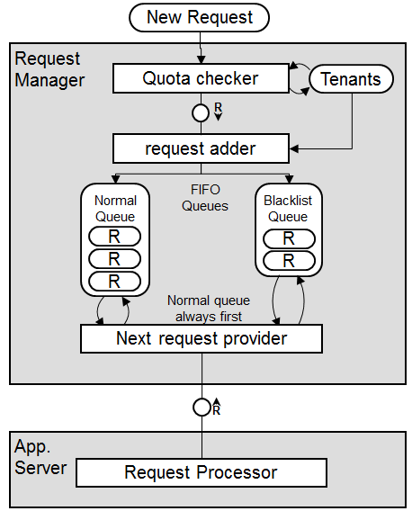
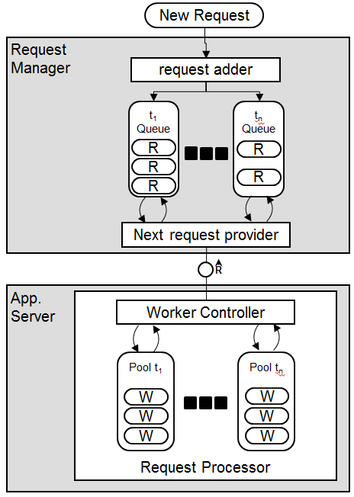
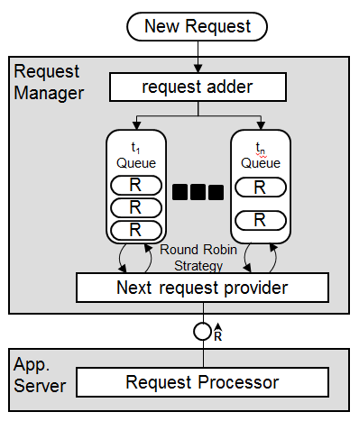
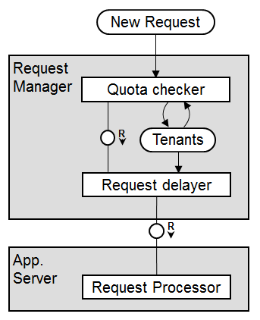
Approaches for Performance Isolation in MT Applications
Add Delay
Round Robin
Blacklist
Separate Thread Pools
Introduction Metrics Isolation Methods Conclusion/Related Work

Slide 22
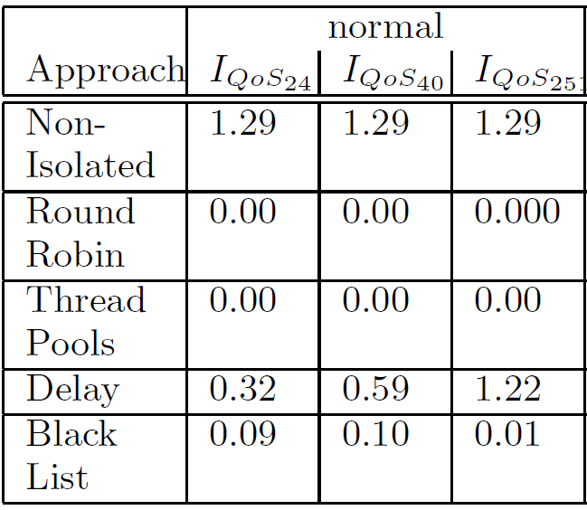
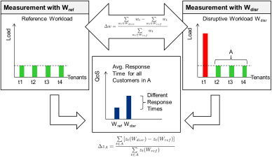
Results: Workload QoS Based Metrics
Introduction Metrics Isolation Methods Conclusion/Related Work

Slide 23
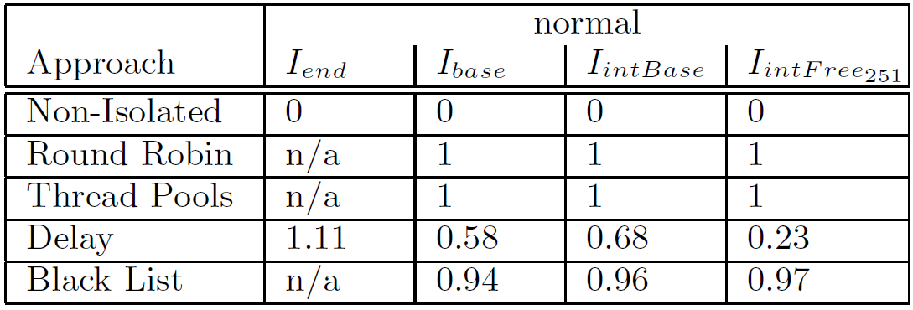
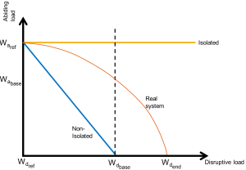
Results: Workload Ratio Based Metrics
Introduction Metrics Isolation Methods Conclusion/Related Work

Slide 24
Discussion/Conclusion
Questions | Metrics | Semantics | Limitations
Q1: influence | I_{QoS} | Reduced QoS based on workload. | No ranking. Only value for isolated system is known.
Q2: relation to non- Isolated | I_{end} | How many times better than non-isolated system. | Not available when system is good isolated.
Q3: potential to improve | Integral based | Ranking within isolated/non-isolated. | Quantification needs two values.
Q1: How strong is one tenant’s influence onto the others?
Q2: How much is a system better isolated than a non isolated system?
Q3: How many potential has the method to improve?
Introduction Metrics Isolation Methods Conclusion/Related Work

Slide 25
Discussion/Conclusion of Approaches
 | Isolation capabilities | Limitations
Round Robin | Fair | No QoS differentiation, inefficient scenarios possible.
Blacklist | Fair | Too hard to disruptive tenant. Burstiness for disruptive and abiding ones.
Delay | Ineffective for high load | Burstiness for abiding tenants.
Threadpool | Fair | Can lead to inefficiency in overcommitted scenarios.
Introduction Metrics Isolation Methods Conclusion/Related Work

Slide 26
Related Work Concerning Metrics
VMmark [3]:
Scores a normalized overall throughput
Focus on hypervisors
No impact of varied load
Georges et al. [2]:
Reflect throughput when additional VMs are deployed.
Do not set the changed workload in relation.
Huber et al. [4]/Koh et al. [5]:
Closely characterize the performance inference of workloads in different VMs.
No metric derived by these results.
Introduction Metrics Isolation Methods Conclusion/Related Work

Slide 27
Related Work Concerning Performance Isolation
Fehling et al. [1]/ Zhang [8]:
Tenant placement onto locations with different QoS.
Tenant placement onto a restricted set of nodes with awareness of SLAs.
Do not guarantee isolation.
Lin et al. [7]:
Request Admission Control
Provide different QoS on a tenant’s base
One test case evaluated the system regarding tenant specific workload changes and their interference.
No setup with high utilization for reference workload.
Introduction Metrics Isolation Methods Conclusion/Related Work

Slide 28
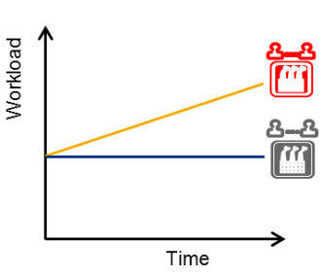
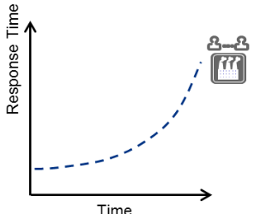
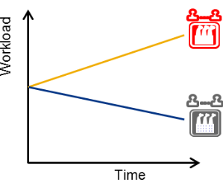
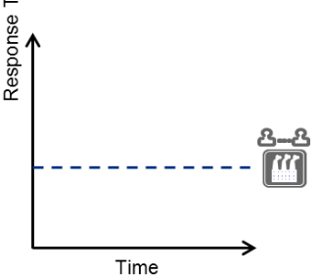
Recap
Performance Isolation is a challenge in shared systems.
Metrics with expressiveness concerning QoS
Observed QoS by increasing workload.
How to quantify performance isolation methods.
Metrics with ranking capabilities
to non isolated
potential to improve
Variable workloads and constant QoS.
Introduction Metrics Isolation Methods Conclusion/Related Work

Slide 29
Ongoing / Future Work
MT Performance Isolation Benchmark
  Mapping these approaches to real existing benchmarks/reference application.
MT Performance Isolation Mechanisms
  Identification + Evaluation of different performance isolation mechanisms
Introduction Metrics Isolation Methods Conclusion/Related Work

Slide 30
References
[1] Fehling, C., Leymann, F., and Mietzner, R. A framework for optimized distribution of tenants in cloud applications. In Cloud Computing (CLOUD), 2010 IEEE 3rd International Conference on (2010), pp. 252 –259.
[2] Georges, A., and Eeckhout, L. Performance metrics for consolidated servers. In HPCVirt 2010 (2010).
[3] Herndon, B., Smith, P., Roderick, L., Zamost, E., Anderson, J., Makhija, V., Herndon, B., Smith, P., Zamost, E., and Anderson, J. Vmmark: A scalable benchmark for virtualized systems. Tech. rep., VMware, 2006.
[4] Huber, N., von Quast, M., Hauck, M., and Kounev, S. Evaluation and modeling virtualization performance overhead for cloud environments. In Proceedings of the 1st International Conference on Cloud Computing and Services Science (CLOSER 2011), Noordwijkerhout, The Netherlands (May 7-9 2011), pp. 563 – 573.
[5] Koh, Y., Knauerhase, R., Brett, P., Bowman, M., Wen, Z., and Pu, C. An analysis of performance interference effects in virtual environments. In Performance Analysis of Systems Software, 2007. ISPASS 2007. IEEE International Symposium on
(april 2007), pp. 200 –209.
[6] Koziolek, H. The SPOSAD architectural style for multi-tenant software applications. In Proc. 9th Working IEEE/IFIP Conf. on Software Architecture (WICSA'11), Workshop on Architecting Cloud Computing Applications and Systems (July 2011), IEEE, pp. 320–327.
[7] Lin, H., Sun, K., Zhao, S., and Han, Y. Feedback-control-based performance regulation for multi-tenant applications. In Proceedings of the 2009 15th International Conference on Parallel and Distributed Systems (Washington, DC, USA, 2009),
ICPADS ’09, IEEE Computer Society, pp. 134–141.
[8] Zhang, Y., Wang, Z., Gao, B., Guo, C., Sun, W., and Li, X. An effective heuristic for on-line tenant placement problem in SaaS. Web Services, IEEE International Conference on 0 (2010), 425–432.

Slide 31
Thank you
Contact information:
Rouven Krebs: Rouven.Krebs@sap.com
Christof Momm: Christof.Momm@sap.com
Samuel Kounev: Kounev@kit.edu
http://www.sap.com/research
http://www.descartes-research.net

Slide 32
Scenario - Simulation
Poolsize configured for 38 Threads to ensure optimal throughput. At 80 users the system achieves 3500ms response time.
Our simulated server
 | Normal |  | overcommited
 | reference | disruptive | reference | disruptive
T0 | 8 | 24, 40, 251 | 24 | 40, 56, 251
T1 | 8 | 8 | 8 | 8
T2 | 8 | 8 | 8 | 8
T3 | 8 | 8 | 8 | 8
T4 | 8 | 8 | 4 | 4
T5 | 8 | 8 | 1 | 1
T6 | 8 | 8 | 1 | 1
T7 | 8 | 8 | 1 | 1
T8 | 8 | 8 | 1 | 1
T9 | 8 | 8 | 24 | 24

Slide 33
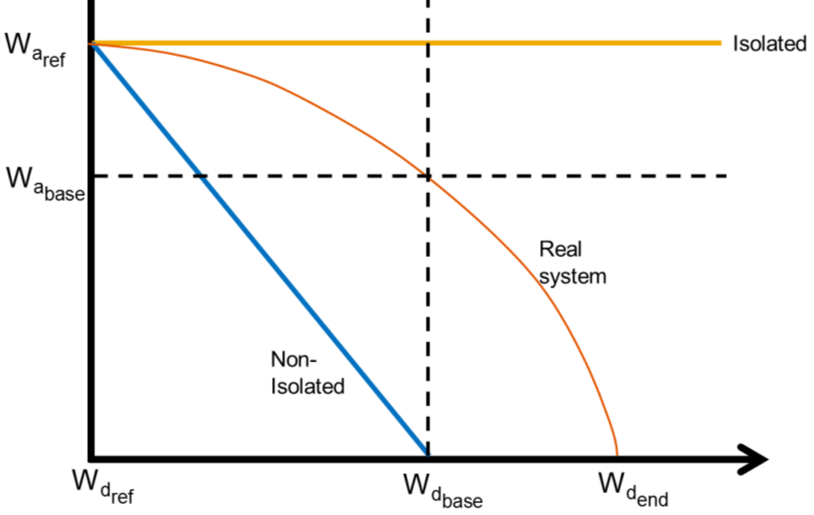
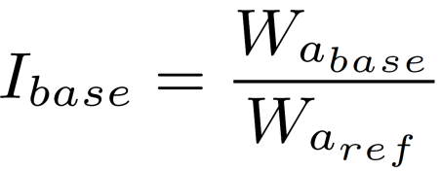
Metrics based on Workload Ratio
Relation of Significant Points: I_{base}
Perfectly Isolation = 1
Non-Isolated = 0
Describes the decrease of abiding workload at the point at which a non-isolated systems abiding load is 0.

Slide 34
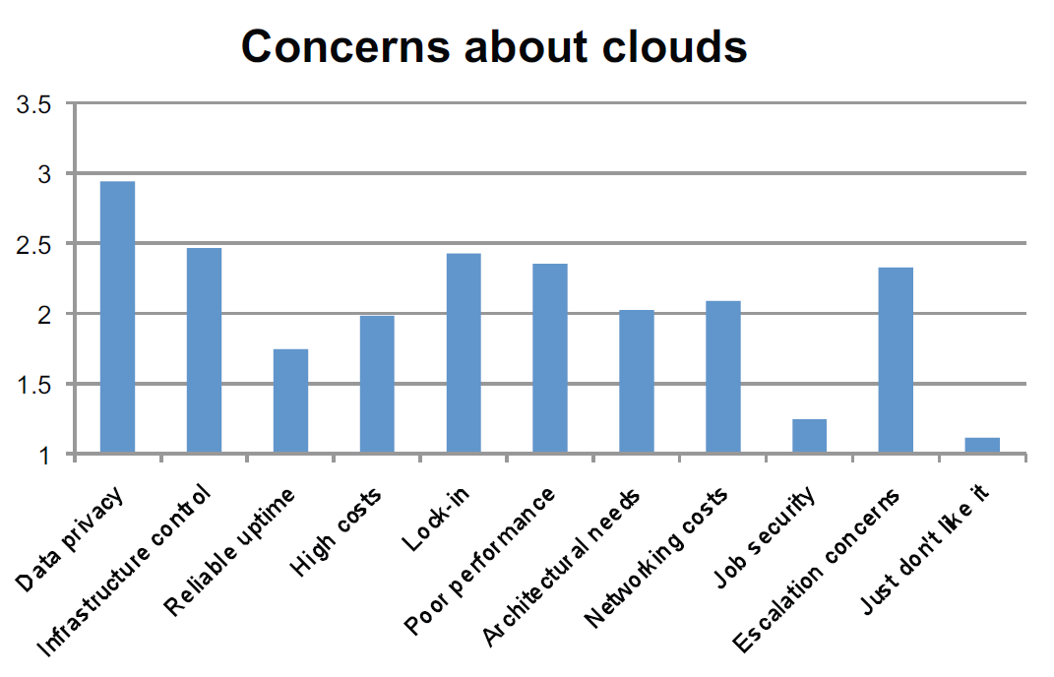
Performance in Cloud matters
[Bitcurrent2011]

Slide 35
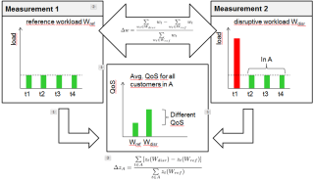
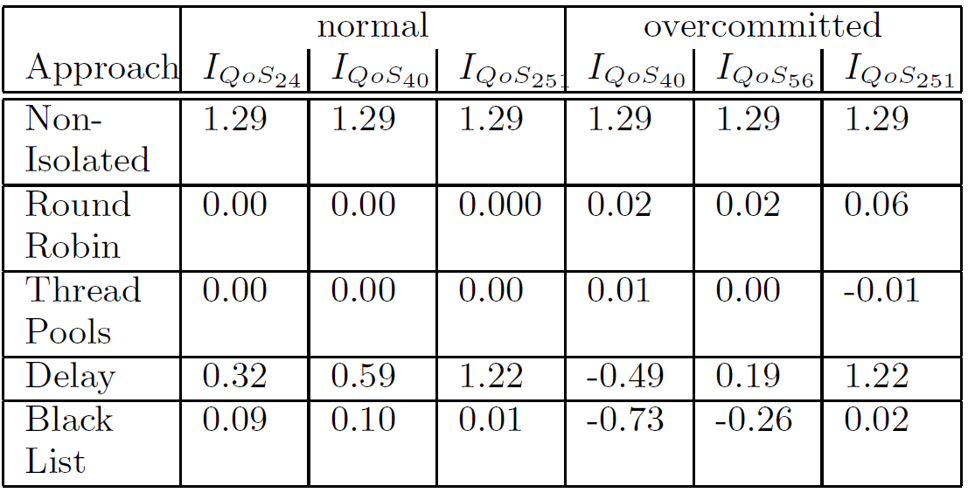
Results: QoS Impact Based Metrics
Negative results as the QoS increased when the disruptive tenant increase load. This happes if disruptive tenant gets completely blocked for a while.

Slide 36
Architectures for Performance Isolation
Client Tier
Application Tier
Database Tier
Web Browser
REST / SOAP
1
2
3
4
5
Data
(Shared Table)
Cache
(optional)
Load Balancer
Application Threads
6
REST / SOAP
Application Threads
Application Threads
Data transfer
Rich Client
REST / SOAP
customizes
Relates to
Meta-Data
Meta-Data Manager
Data transfer
1
Admission Control
4
Thread Priorities
2
Cache Restrictions
5
Thread Pool Sizes
3
Load Management
6
Database Admission
Architectural Style based on [6]

Slide 37
Approach 1: Add Delay for Users Exceeding Quotas
  Quota checker checks if the quota for a tenant is exceeded
  Quotas and current usage information are maintained in tenant data
  If user is exceeds quota, request delayer adds custom delay
  After delay requests are forwarded to Server
New Request
Request
Manager
Quota checker
R
Tenants
Request delayer
R
App.
Server
Request Processor

Slide 38
Approach 2: Request-Queueing per Tenant + Round-Robin
New Request
Request
Manager
request adder
  Requests are queued in separate queues for each tenant
  Round-robin support used for getting next request if Request Processor has free resources.
t₁
Queue
t_{n}
Queue
R
R
R
R
R
Round Robin
Strategy
Next request provider
R
App.
Server
Request Processor

Slide 39
Approach 3: Request-Queueing with Blacklist Queue
New Request
Request
Manager
  Triggered by each incoming request, the quota checker checks if the quota is exceeded and blacklists users
  Quotas and blacklist information are maintained in tenant data
  Requests by blacklisted users are put in separate queue
  Requests from blacklist queue are only returned by next request provider if normal queue is empty
Quota checker
Tenants
R
request adder
Normal
Queue
FIFO
Queues
Blacklist
Queue
R
R
R
R
R
Normal queue
always first
Next request provider
R
App.
Server
Request Processor

Slide 40
Approach 4: Separate Thread Pools
New Request
Request
Manager
request adder
  Simple FIFO queue for all tenants
  Work controller only assigns request to leader if no busy worker is already working for this user.
  If tenant is already served, work controller adds request to queue as last element
t₁
Queue
t_{n}
Queue
R
R
R
R
R
Next request provider
R
App.
Server
Request Processor
Worker Controller
Pool t₁
Pool t_{n}
W
W
W
W
W
W

Slide 43
The Grid
Headline area
White space
Drawing area

