Slide 1


Taxonomy for Cloud Computing and
Common Cloud Usage Patterns
Michael Faber michael.faber@kit.edu
Samuel Kounev kounev@kit.edu
http://descartes.ipd.kit.edu
http://research.spec.org

Slide 2
Proposed Next Steps
1. Taxonomy for the cloud space
  Better understanding of different offerings and cloud usage patterns
  Consistent terminology as a basis for further discussions
2. Systematic classification of different cloud benchmarks
  What metrics are relevant at each layer and for each party?
  How can metrics be measured and quantified?
3. Appropriate scenarios for research benchmarks
  Promising application types
  Simple and easy to understand
  Accomodate more than one cloud usage pattern
Continue close collaborations with OSG Cloud

Slide 3
Motivation
Cloud computing is still a very developing trend
Important to identify
  Characteristics (taxonomy)
  Cloud usage patterns
Benefits
  Common terminology and understanding
  Identification of
    Benchmark scenarios
    Target groups
    Benchmarking approaches (black-box, white-box)

Slide 4
taxonomies

Slide 5
Taxonomy – Cloud Characteristics I
Different approaches in literature
  Overall taxonomies [OliveiraBaiaoMattoso2010] [RimalChoiLumb2010]
  IaaS offerings [Abbadi2011] [ProdanOstermann2009]
  …
Identified characteristics by
  Cloud layer
    Client (security, identity, etc.)
    Server and storage (processing power, memory, etc.)
    Internet (speed, reliability, availability)
  Offering
    SaaS (service quality and performance, elasticity, etc.)
    PaaS (tools and support, etc.)
    IaaS (security, provision and deployment logic, etc.)
Source: OSG Cloud

Slide 6
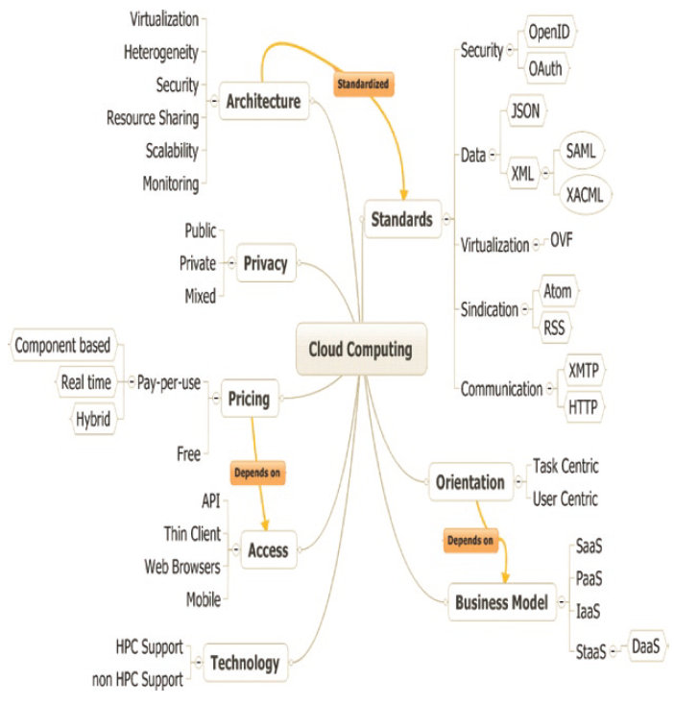
Taxonomy – Cloud Characteristics II
Source:
D.D. Oliveira, F.A. Baião, and M. Mattoso, “Cloud Computing,” Computer Communications, 2010, pp. 47-62.
„Towards a Taxonomy for Cloud Computing from an e-Science Perspective“

Slide 7
Cloud usage pattern

Slide 8
Cloud Usage Patterns
IaaS / PaaS / SaaS abstraction layers [Armbrust et al. 2010]
  Too generic and coarse-grained
Identification of common patterns [Petcu2010]
Fine-grained usage scenarios
Dimensions
  Actor (organizations, end-user)
  Roles (consumer, provider, intermediary)
  Privacy (public, private, mixed)
  Abstraction-Level (HW, IaaS, SaaS, PaaS)

Slide 9
Common Patterns in Cloud Computing
End-User
Actor:
Organization
End-User
SaaS
Roles:
Consumer
Provider
PaaS
SLAs:
Internal
External
IaaS
Virtualization
HW
A
B
C
D
E
F
G

Slide 10









Common Patterns – Examples
End-User
Actor:
Organization
End-User
SaaS
Roles:
Consumer
Provider
PaaS
SLAs:
Internal
External
IaaS
Virtualization
HW
A
B
C
D1
D2
E
F
G

Slide 11
Target Groups for Benchmarks
Cloud user (public clouds)
  Public IaaS / PaaS / SaaS offerings
  Is it worth to use cloud offering? (e.g., price)
  Which offering? (e.g., price, reliability, scalability)
Intermediary provider
    Which IaaS provider fits best? (e.g., price, scalability)
Cloud provider
  How efficient is the cloud? (e.g., resource utilization, power consumption)
  Find a good cost/efficiency/QoS tradeoff
  Which cloud software fits best?
Hardware vendors
  How can we optimize and combine HW for usage in cloud computing?
Academics
  Scenario to validate research results

Slide 12
Different Benchmark Views and Goals
End-User
Response time
throughput
availability
Black-box
Service
Actor:
Organization
End-User
Cost efficient usage of provided resources
Gray-box
(VM internal)
Product
SaaS
Roles:
Consumer
Provider
Reserved hardware
Elasticity, price
Black-box
Service
PaaS
SLAs:
Internal
External
Different cloud software (Eucalyptus, Nimbus)
White-box
Product
IaaS
Appropriate hardware: CPU, main memory, etc.
White-box
Product
Virtualization
HW
C

Slide 13
Discussion and Questions
Identify most common patterns
Prioritize relevance of all patterns for benchmarking
Prioritize importance of target groups and their goals

